Slide 1
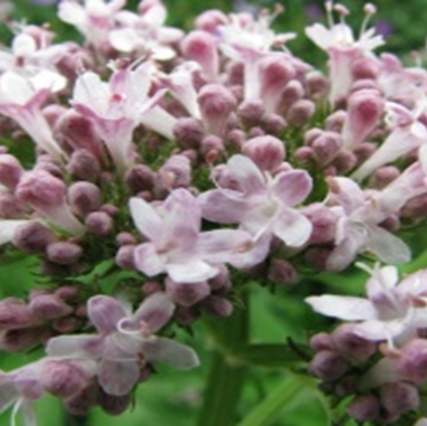
Valerian
Use: In infusion form it acts as a mild sedative,
but also helps to treat insomnia.

Slide 2
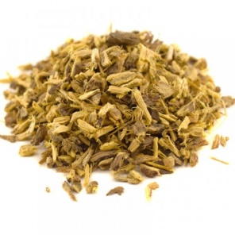
Licorice
Use: The decoction has antispasmodic effect and is used in stomach upsets. It is also very effective in dry cough as an emollient and expectorant.

Slide 3
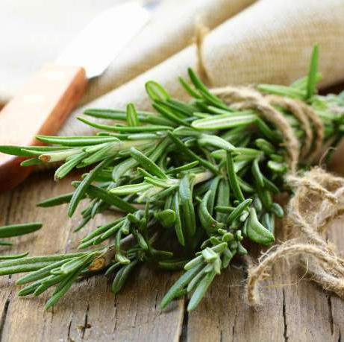
Rosemary
Use: Externally used in skin irritations and abrasions for rheumatic diseases, because it causes local hyperemia. When taken internally, it acts as a tonic, as an emmenagogue and abortifacient. The infusion can also be used against dandruff, as a final rinse for the hair.

Slide 4
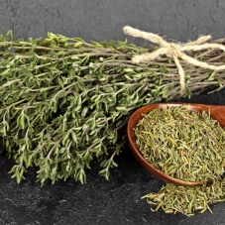
Thyme
Use: The infusion is used for chest infections and as an expectorant in bronchial runny nose.

Slide 5
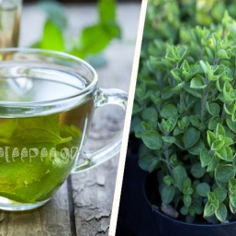
Oregano
Use: The infusion is given against cough, bronchial cold and generally in diseases of the respiratory tract. It is used as a diuretic, in disorders of the urinary system, in abdominal algae, as well as for gargling and rinsing the mouth. It is anti-inflammatory for the larynx and gums. Chewing oregano relieves toothache.

