Slide 1
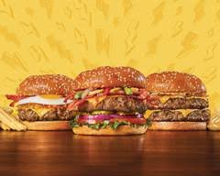
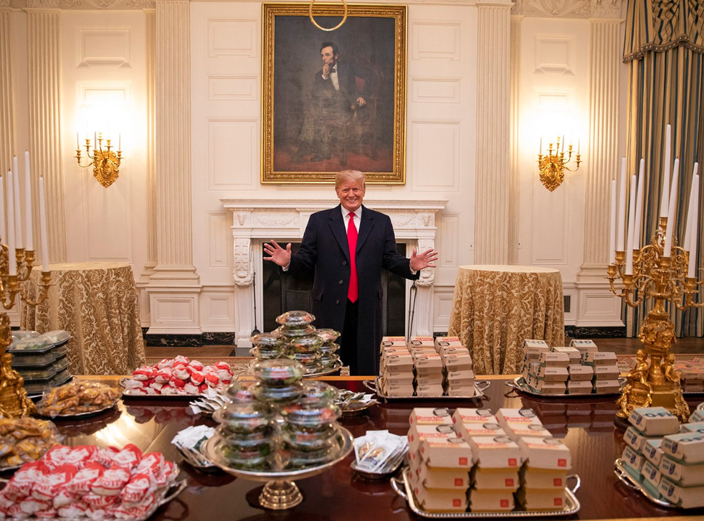
BURGERS OF BURGIRS

Slide 2



Once upon a time there were two kids. Their names were Hu tao and Larry. Their parents Demos and Eleni loved their kids so much so they bought for them a machine which made hamburgers

Slide 3



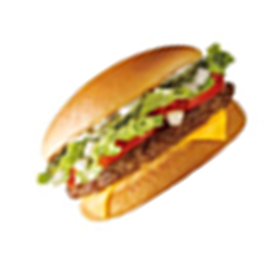
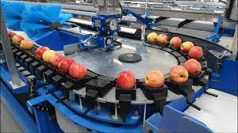
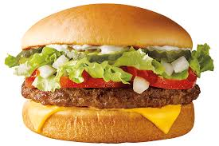
Hu tao and Larry loved hamburgers so much that they tried the machine right away. The machine was working perfectly fine until there was a technical problem…….. and hamburgers were produced in huge quantities. Even if someone turned off the machine or unplugged it, it did not stop production.

Slide 4
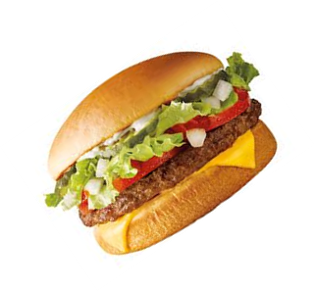
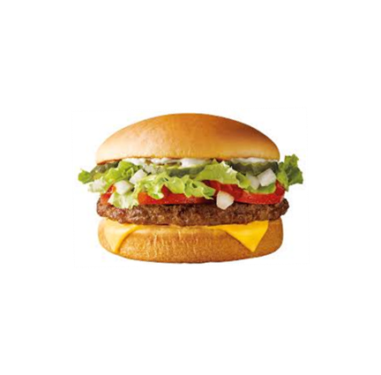

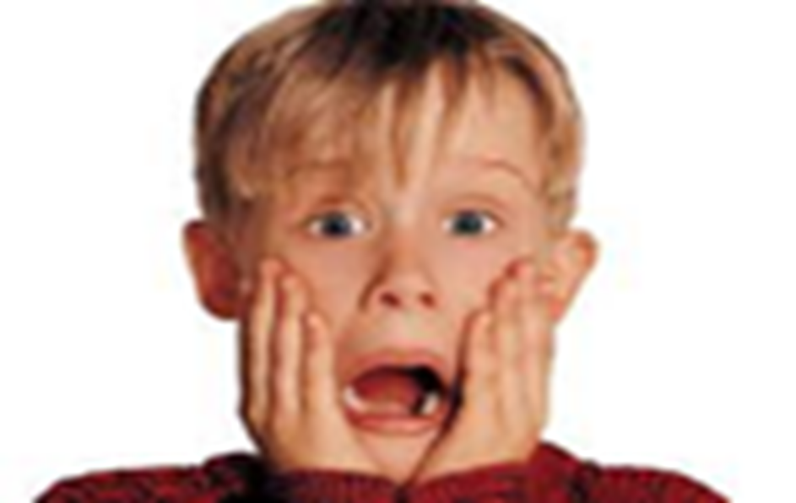

As a result in one hour the hamburgers were found all over the country. The pedestrians could not walk in the streets because the hamburgers covered all the streets……..some of them were in the houses’s yards, some climbed the trees and some other were in the park where the kids were playing.

Slide 5
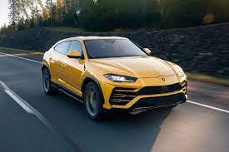
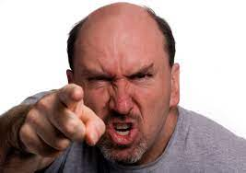
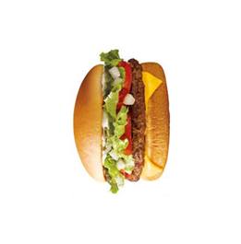
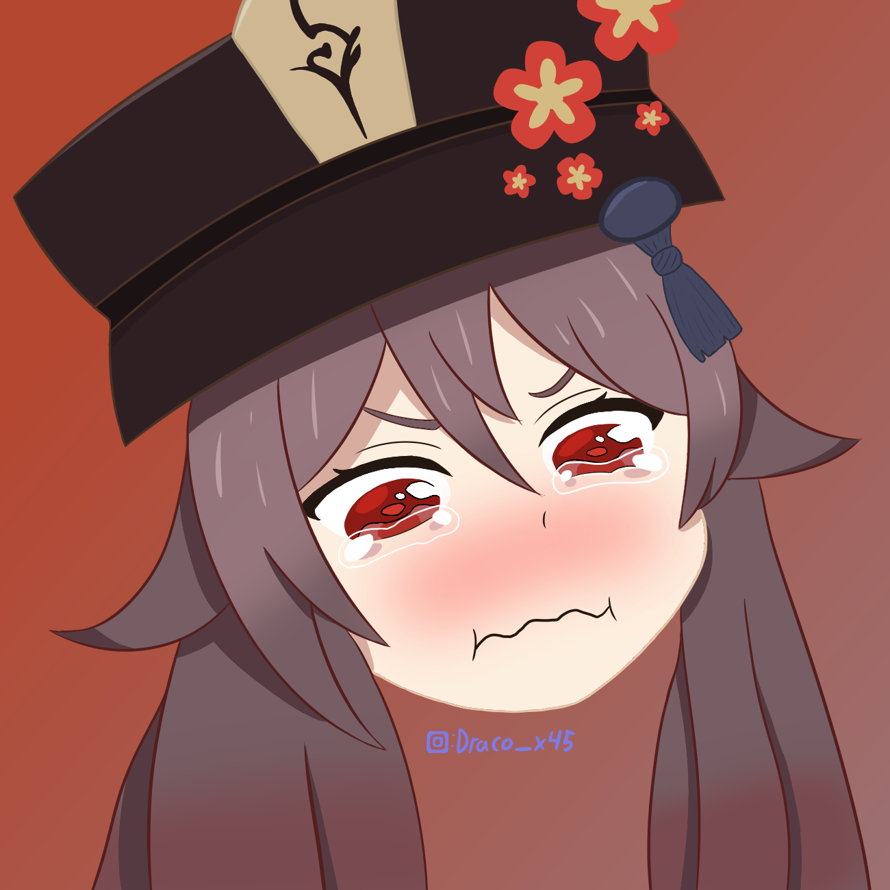
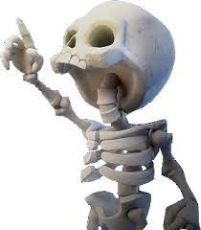

Hu tao and Larry were confused, and they did not know what to do. People were laughing at the beginning but soon they were yelling at the two kids because in a while this situation caused many traffic problems!!! Some poor and homeless people seemed very happy because they found free food.

Slide 6
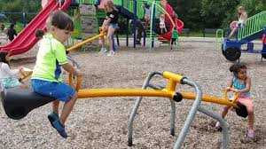

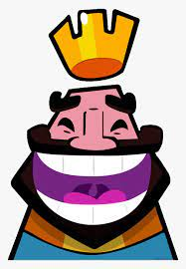


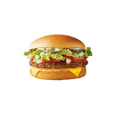
The kids at the park were happy too because they found something new to play with…..they were throwing each other the hamburgers….!! This new game was named by the kids ‘the hamburger fight’!

Slide 7
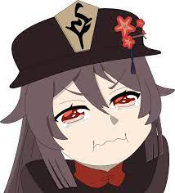

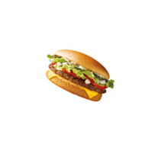
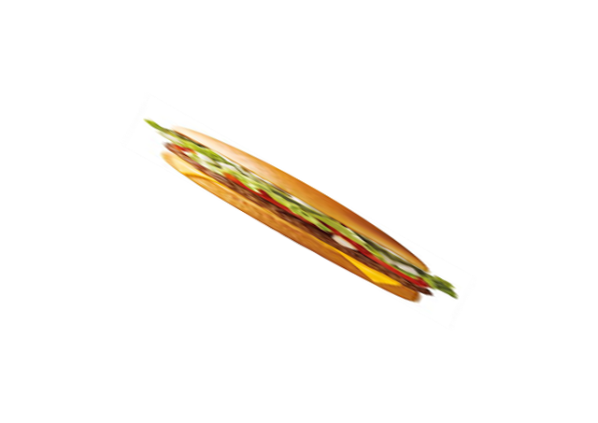
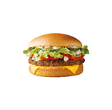

Burgers of burgirs
Hu tao and Larry suddenly had an idea. They returned home and found Hu the machine’s manual. At the last page of the manual there was a magic password…. BURGERS OF BURGIRS…. They shouted loudly that code for three times in front of the machine and that was the end…..it stopped producing hamburgers. They were so happy and relaxed. They went out in the streets and donated the hamburgers to everyone…even to shelters!

Slide 8
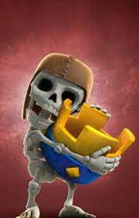
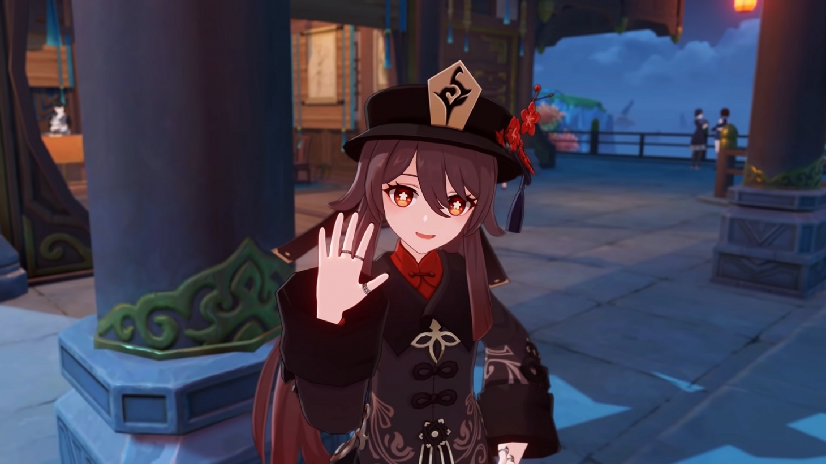
The people in the town were so happy that this massacre ended an Hu tao and Larry went to their parents and didn’t want any further trouble!

Slide 9
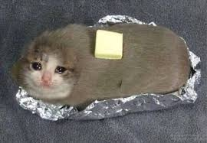
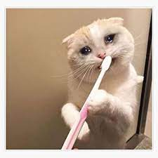
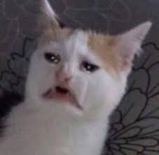
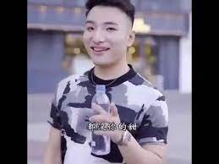
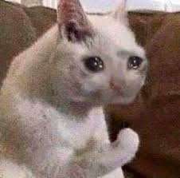
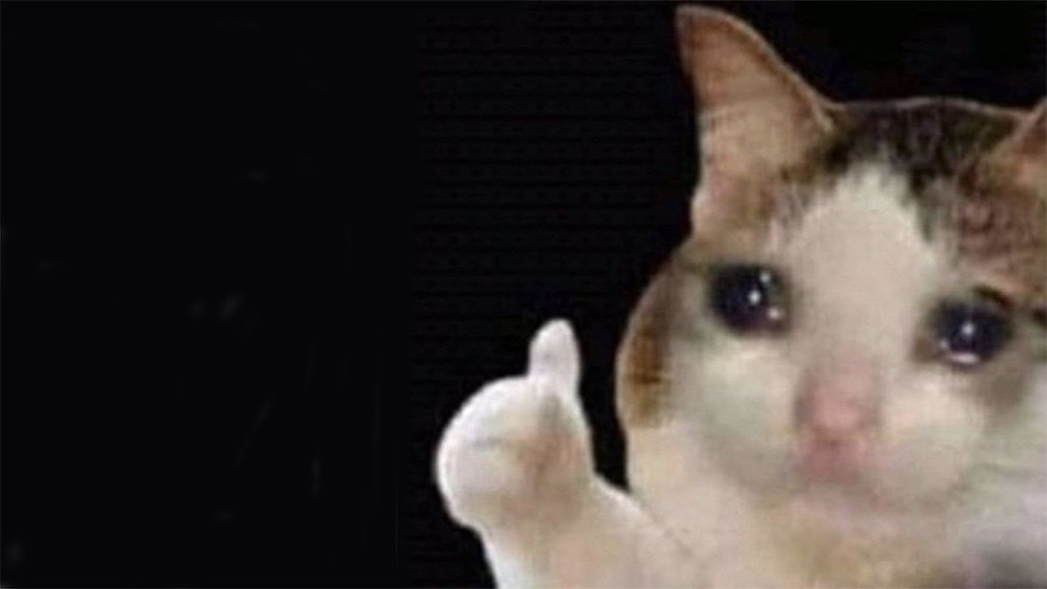

THANKS FOR YOUR PATIENCE!!!!!

