Slide 1
Frank Sinatra

Slide 2
Frank Sinatra is a famous American singer and actor. He was born on December, 12th, 1915 in Roboken,New Jersey U.S.A.

Slide 3
Frank’s music carreer
Sinatra began singing professionally as a teenager, but he learned music by ear and never learned to read music. In 1964, he performs “Fly me to the moon’’ for the first time.
“Fly me to the Moon” is my favourite song!

Slide 4
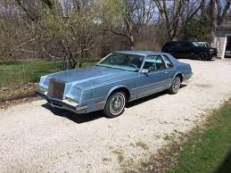
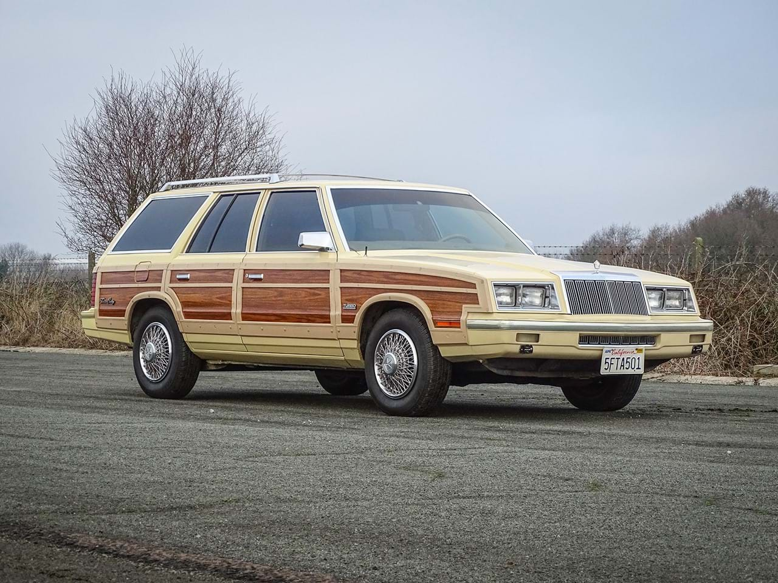
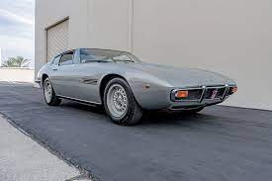
Frank’s love for cars!
Frank Sinatra owned a 1967 Lamborghini Miura

Slide 5
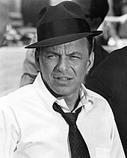
Sinatra died in Los Angeles on May 14, 1998, aged 82. He was "the greatest singer of the 20th century".

