Slide 1
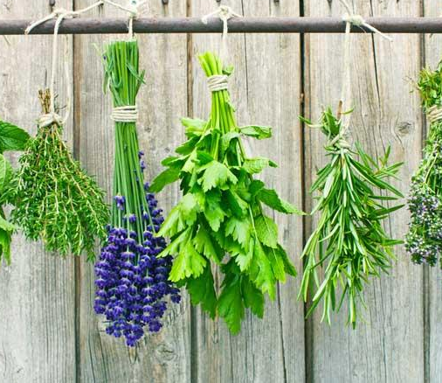
Herbs to the rescue!
By the 6th Graders
Tamasos Primary School
October 2021

Slide 2
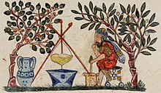
People have been using herbs for medical reasons for over sixty thousand years! Isn’t this amazing?

Slide 3
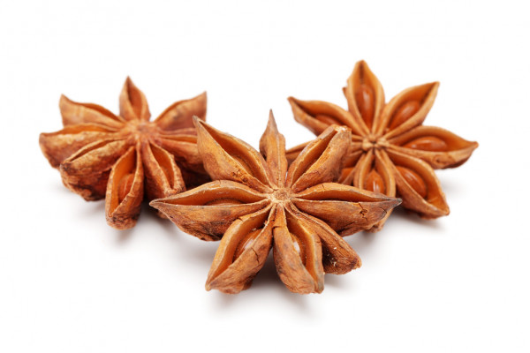
Anise
May Reduce Symptoms of Depression
Can stop Stomach ache
May Balance Blood Sugar Levels

Slide 4
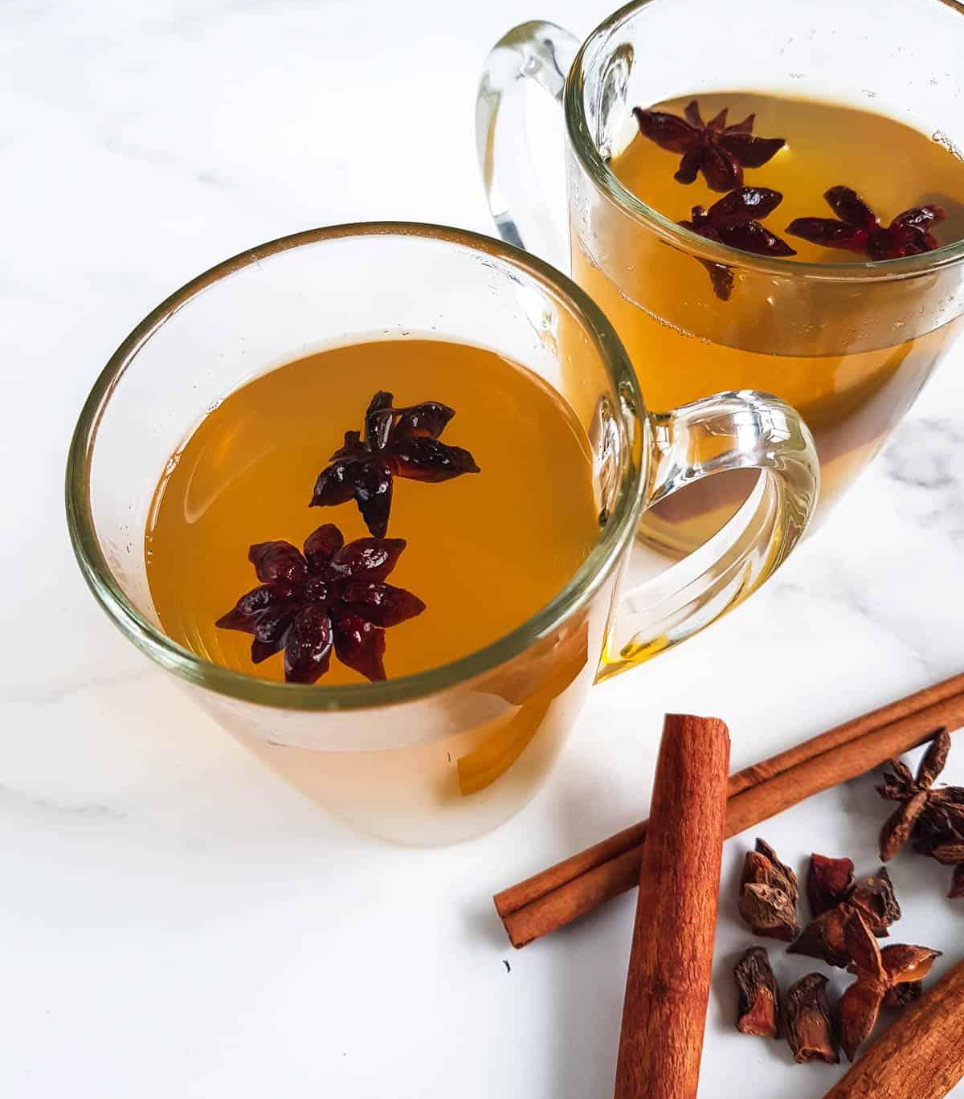
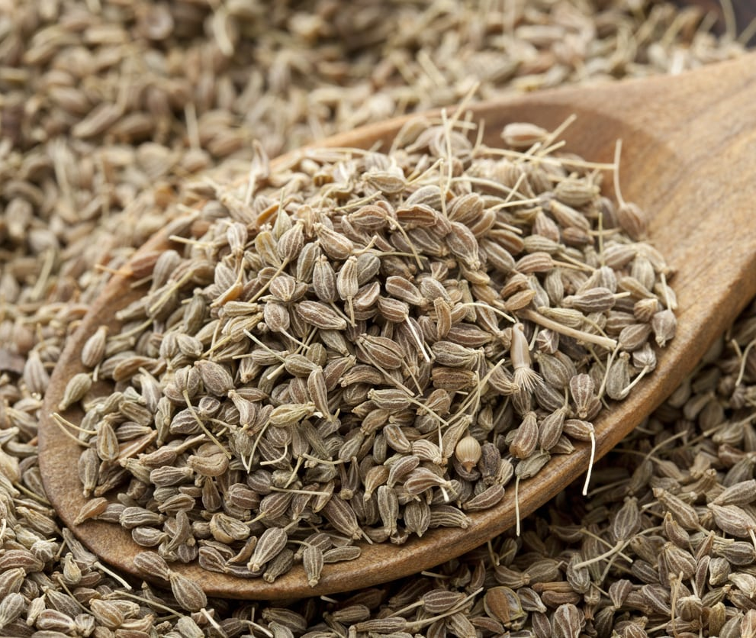

Slide 5
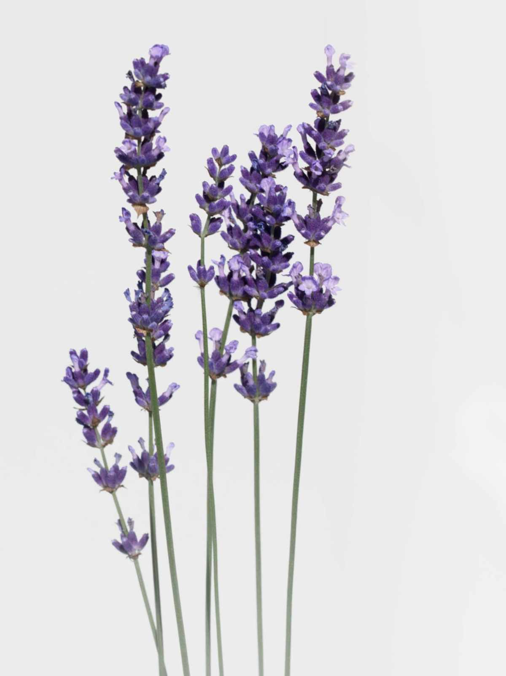
Lavender
What is lavender
good for?
Lavender oil can help heal minor burns and bug bites. Also, it may be useful for treating anxiety, insomnia and depression.

Slide 6
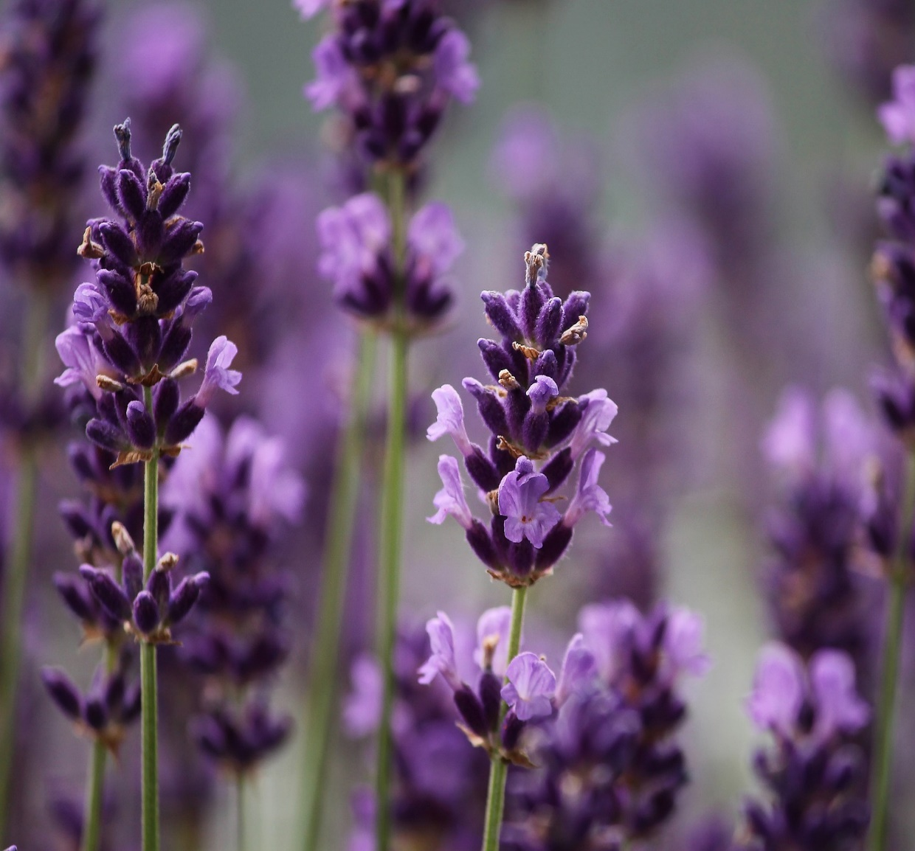
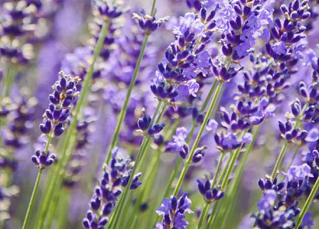
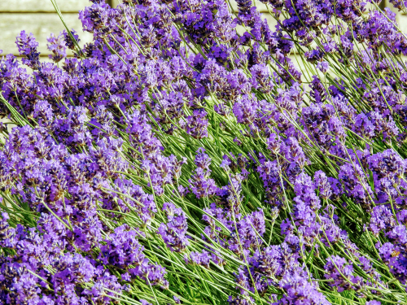

Slide 7
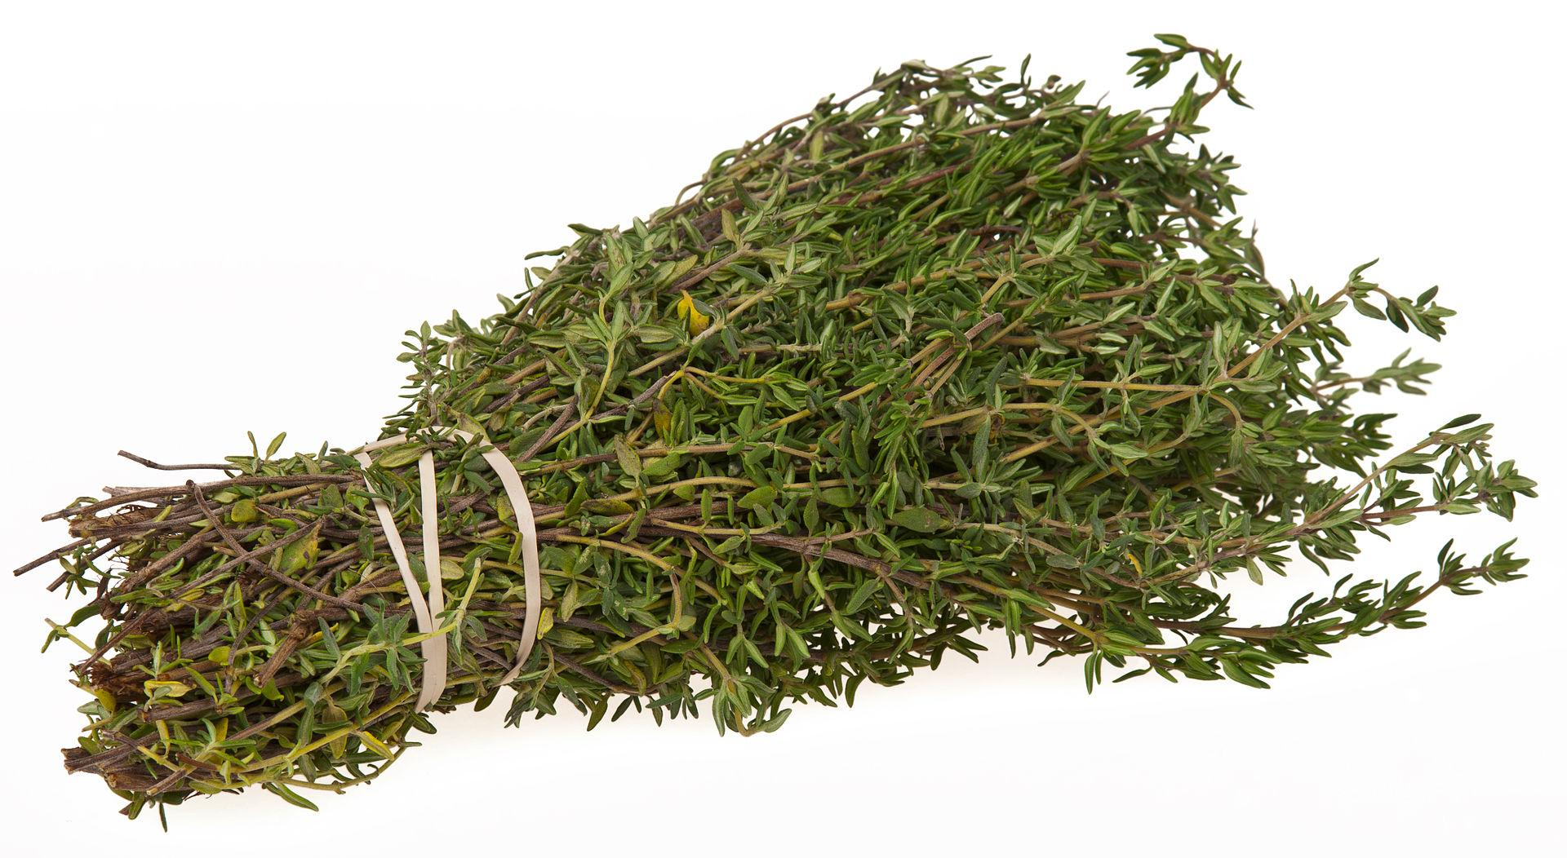
Thyme
What is THYME good for?
Thyme is taken for:
Cough
Sore throat
Colic
Upset stomach
Skin disorders

Slide 8
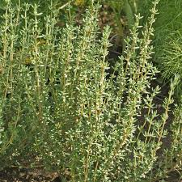
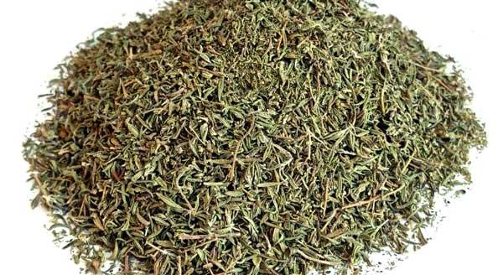
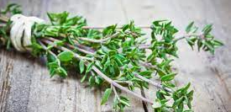

Slide 9
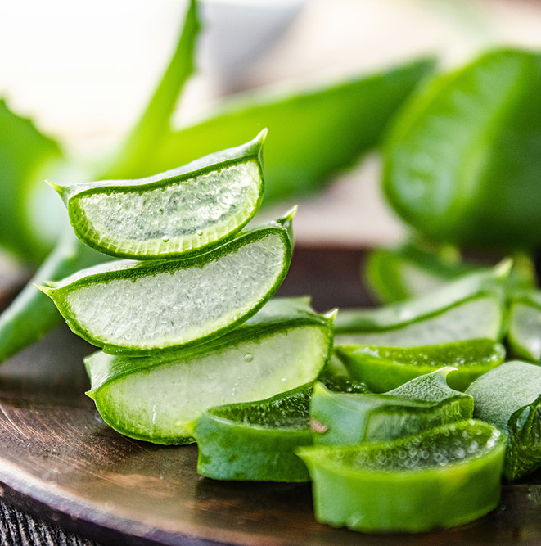
Aloe Vera
Aloe Vera is used by many people when their stomach hurts.
Many people put the liquid on their wounds to heal.

Slide 10
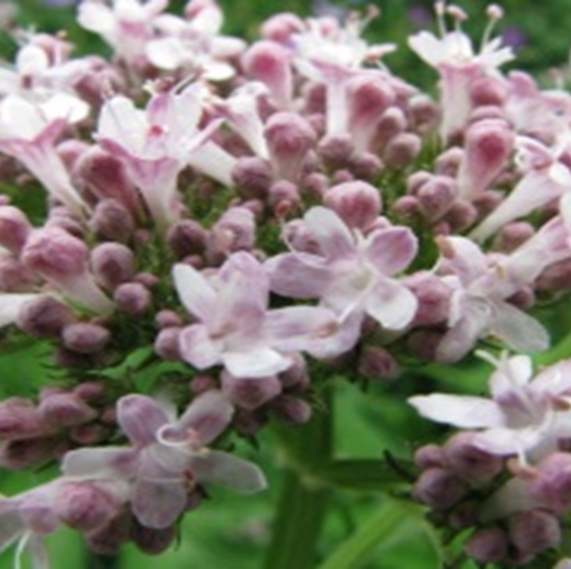
Valeriana
Use:
Mild sedative,
Helps to treat insomnia.

Slide 11
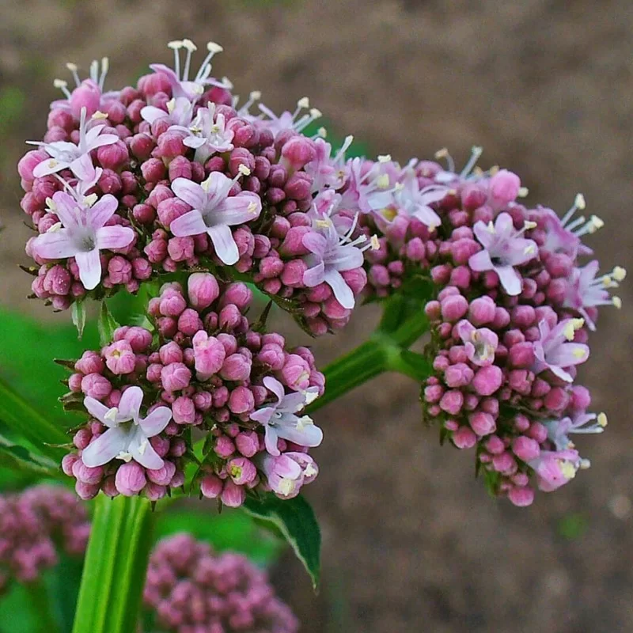
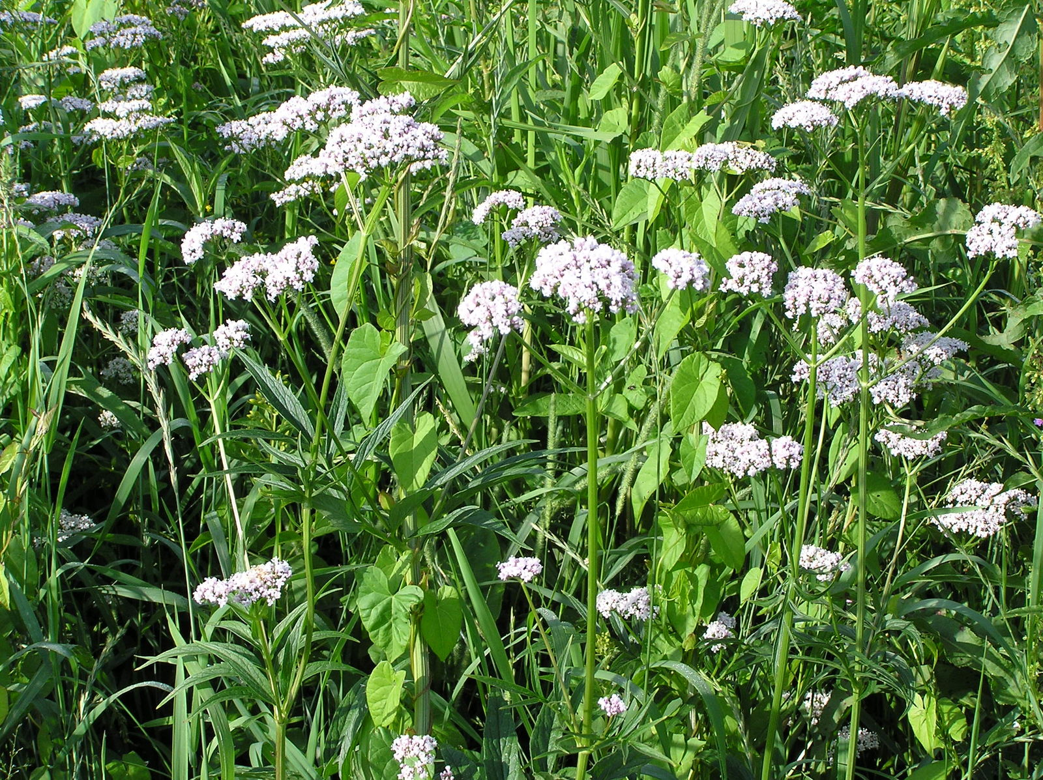
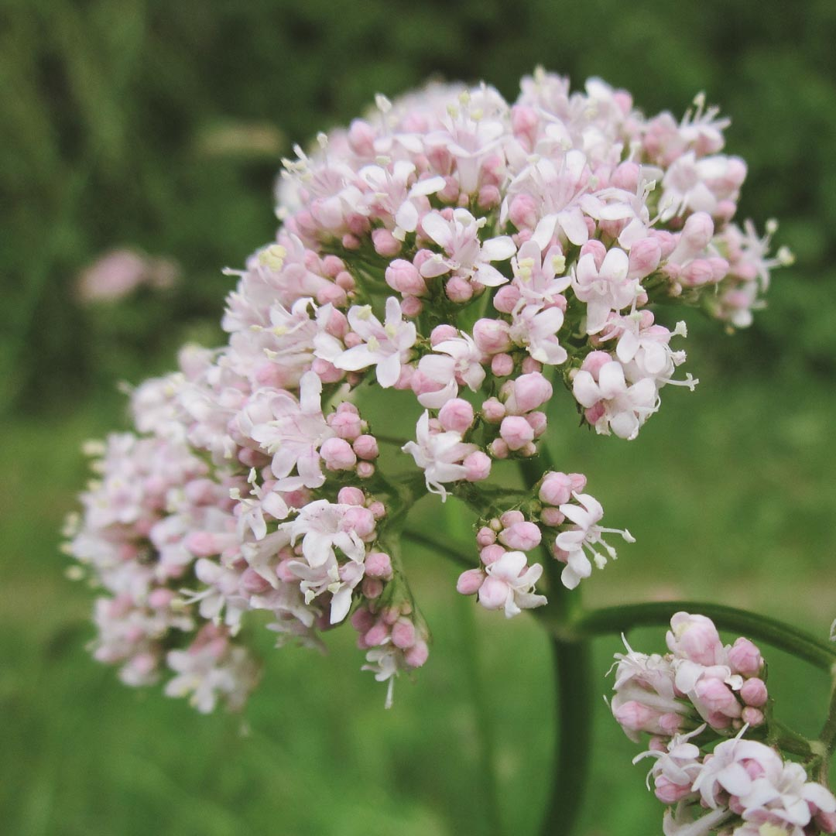

Slide 12
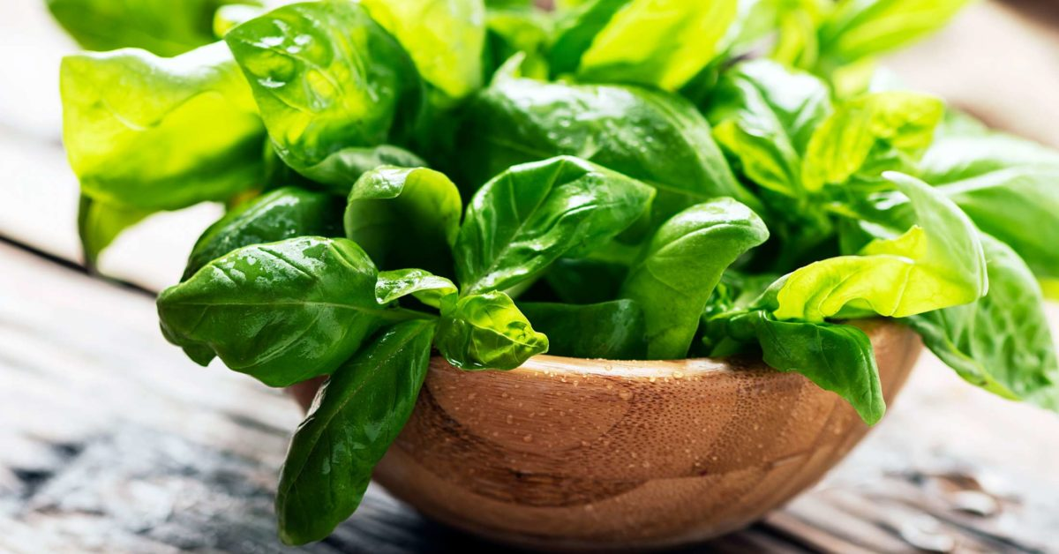
Basil
This herb has been shown to boost your body's health in a variety of ways. Basil helps when you have trouble with your memory. It can help protect against infection, lower your blood sugar, lower your cholesterol, ease joint pain, and protect your stomach.

Slide 13
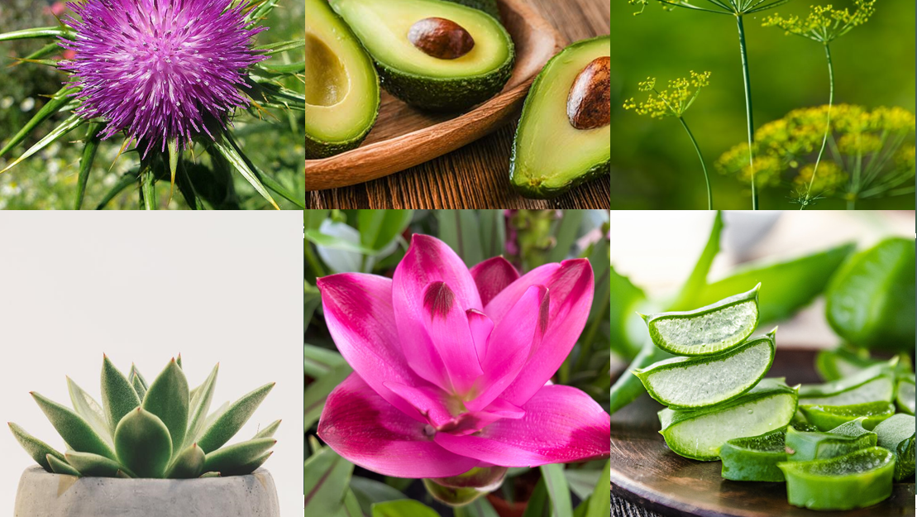
THE END
THANK YOU FOR YOUR ATTENTION

