Slide 1
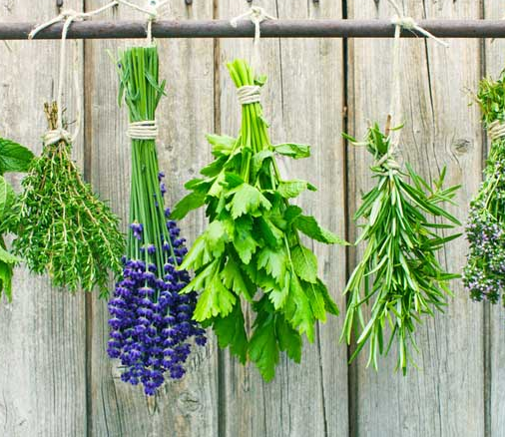
Herbs to the rescue!
By Class 6B
Tamasos Primary School
October 2021

Slide 2
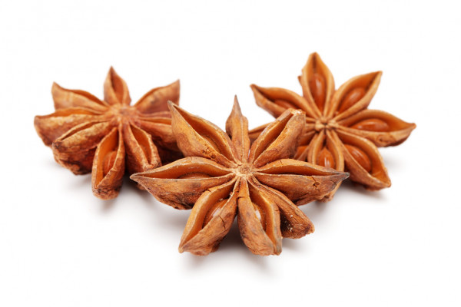
Anise
Health Benefits and Uses of Anise Seed
May Reduce Symptoms of Depression
Can stop Stomach ache
Prevents the Growth of Fungi and Bacteria
May Balance Blood Sugar Levels
Can Reduce Inflammation

Slide 3
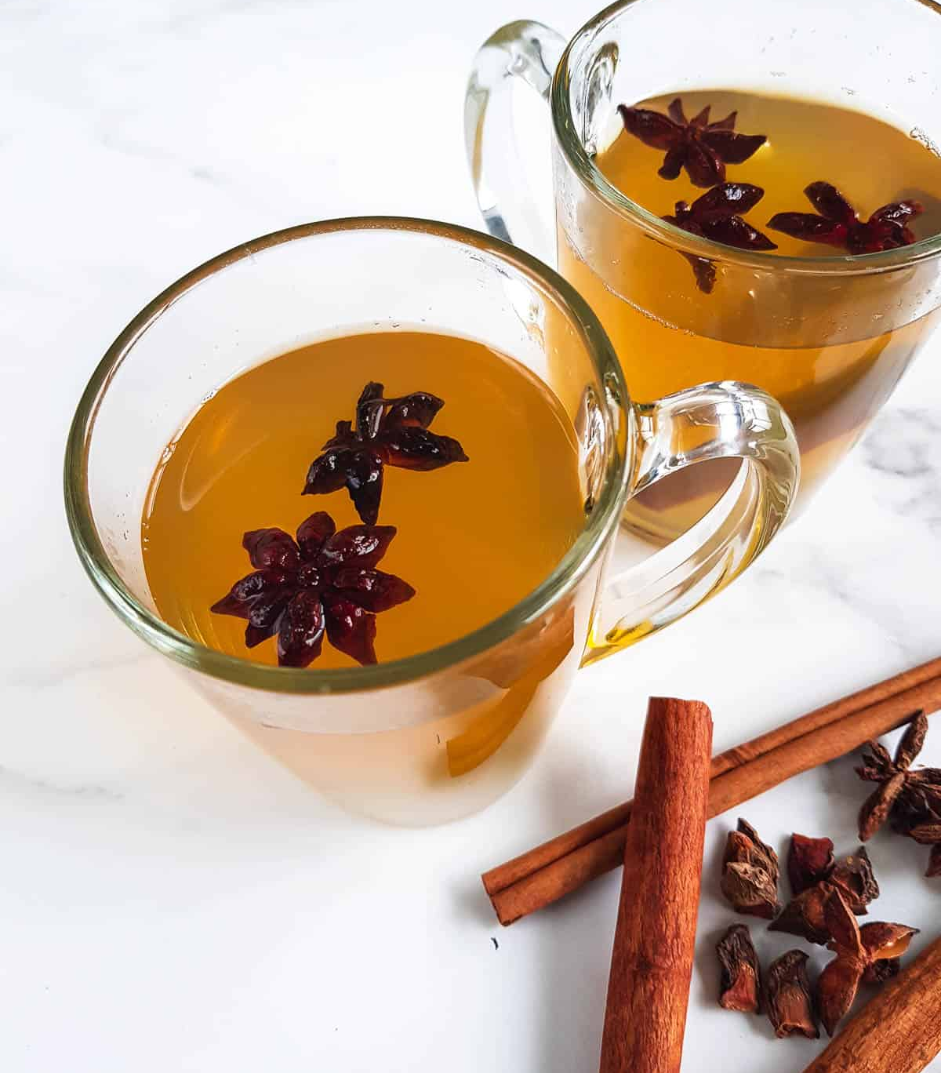
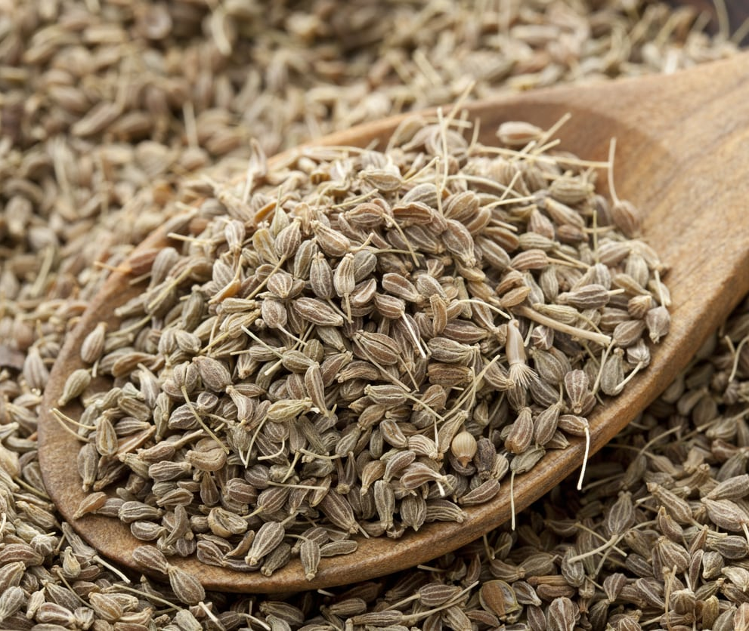

Slide 4
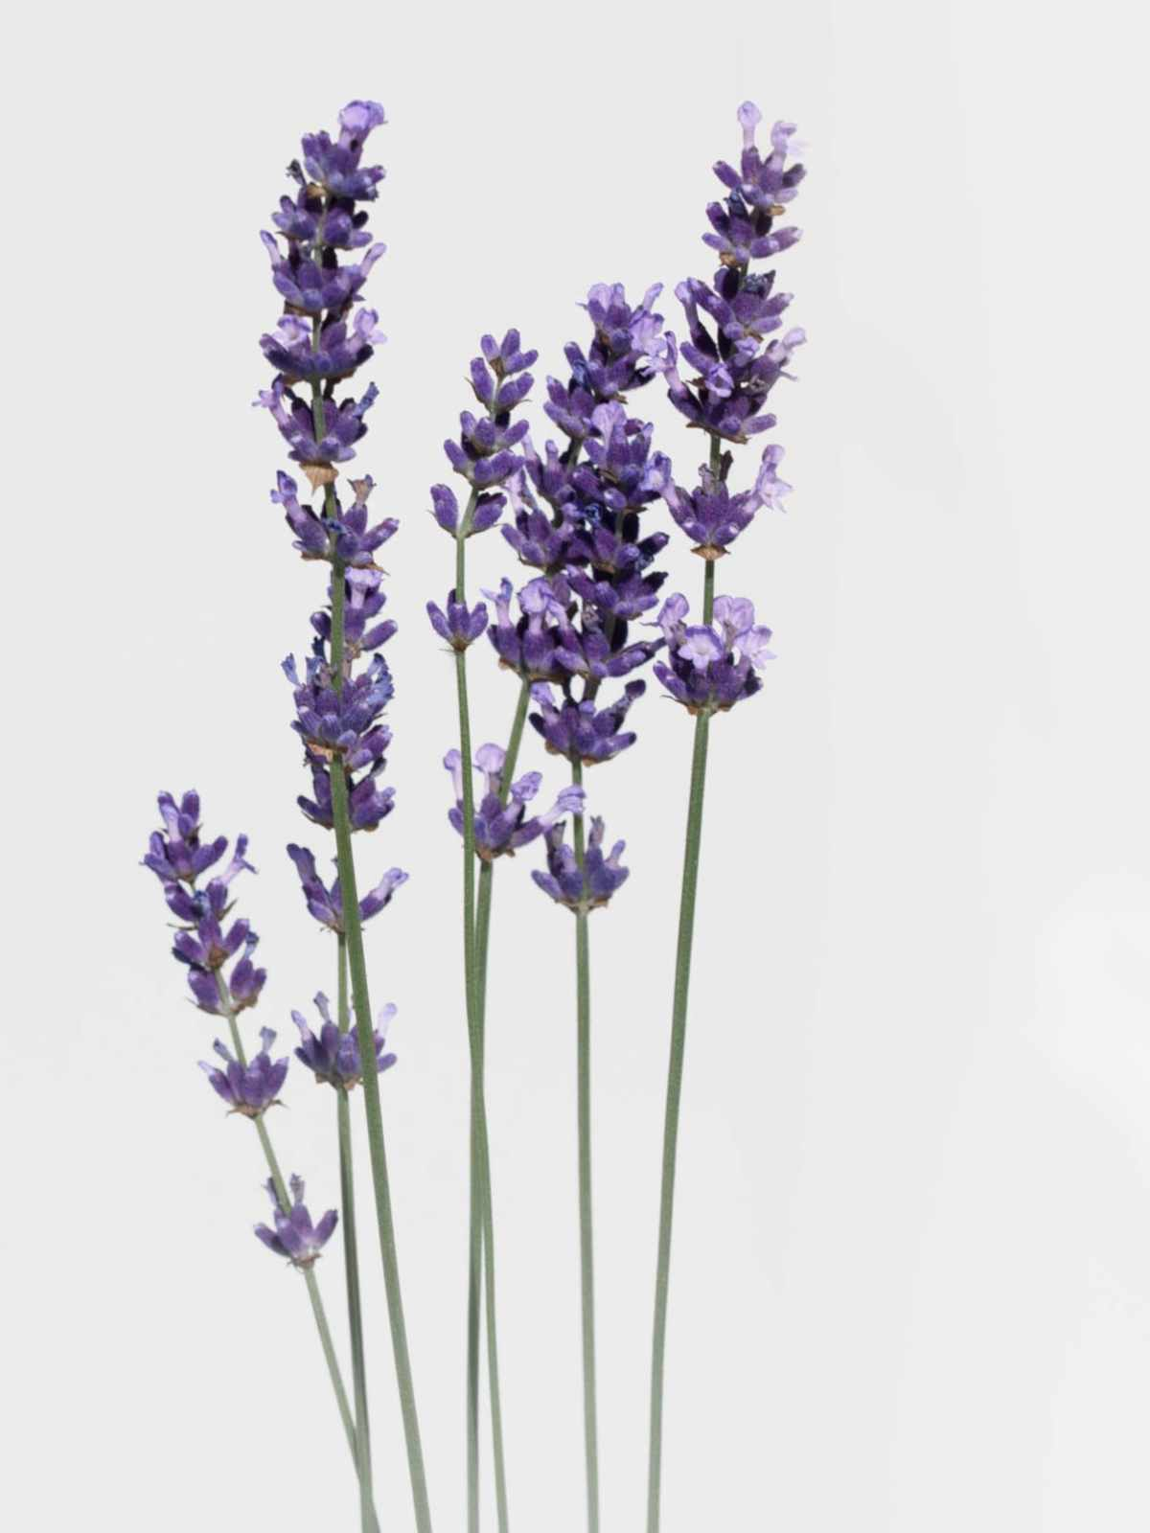
Lavender
What is lavender good for?
Lavender oil is believed to have antiseptic and anti-inflammatory properties, which can help to heal minor burns and bug bites. Also, it may be useful for treating anxiety, insomnia, depression, and restlessness.

Slide 5
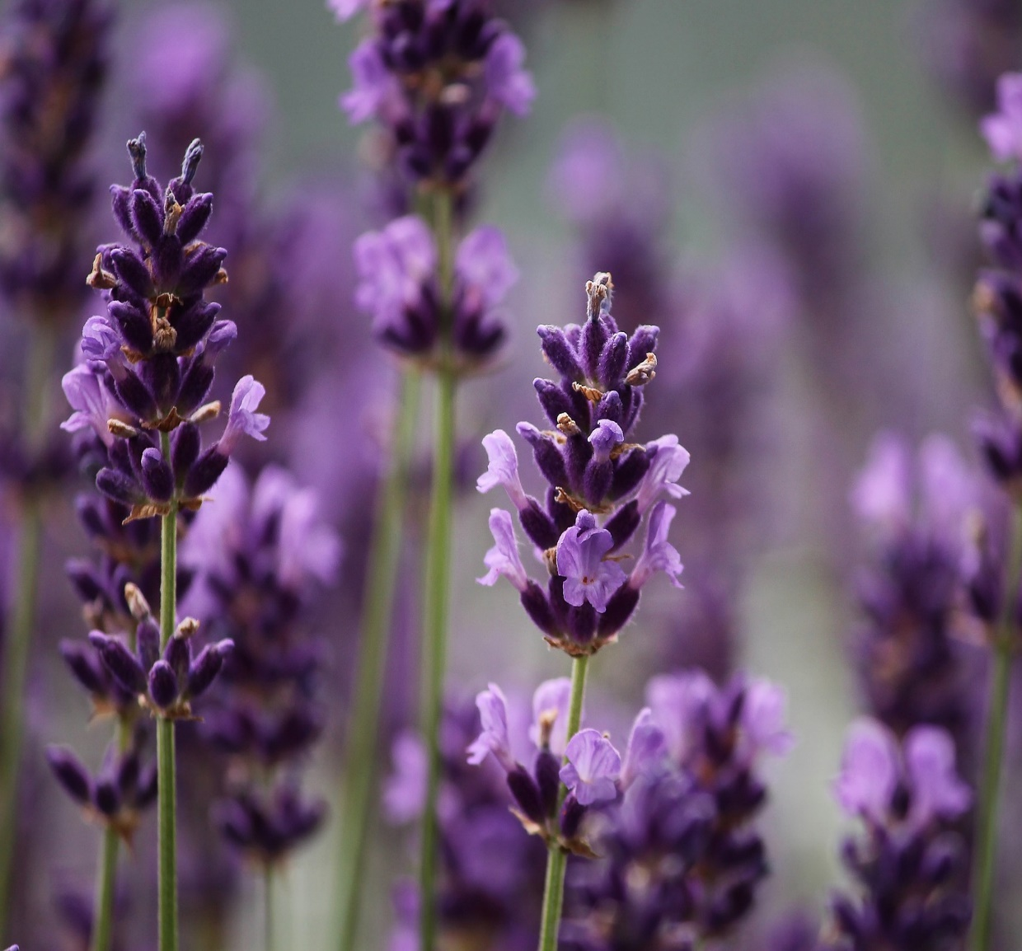
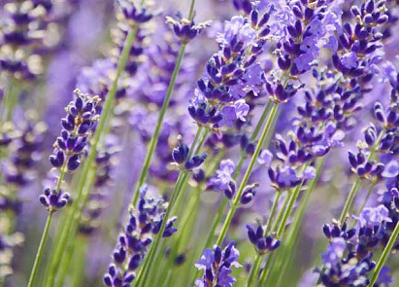
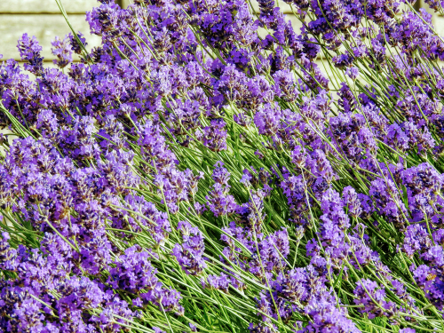

Slide 6
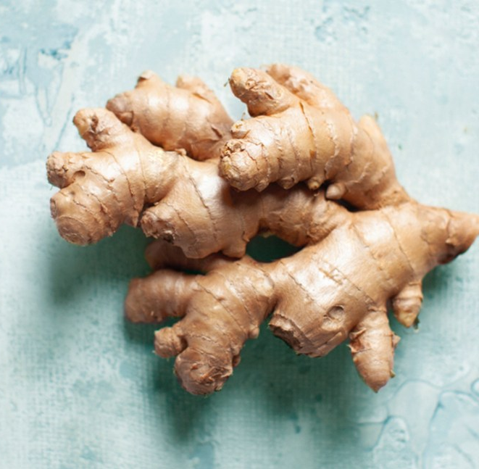
Ginger
What is ginger good for?
Ginger has a very long history of use in various forms of traditional and alternative medicine. It’s been used to aid digestion, reduce nausea, and help fight the flu and common cold, to name a few.

Slide 7
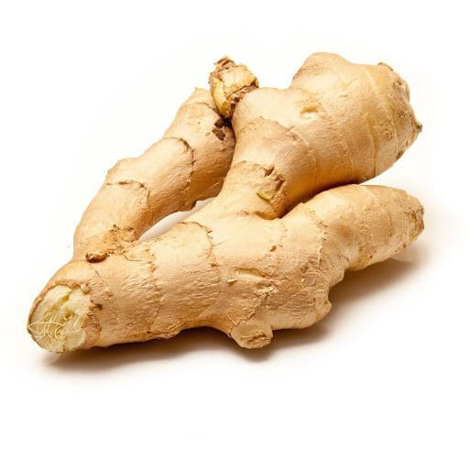
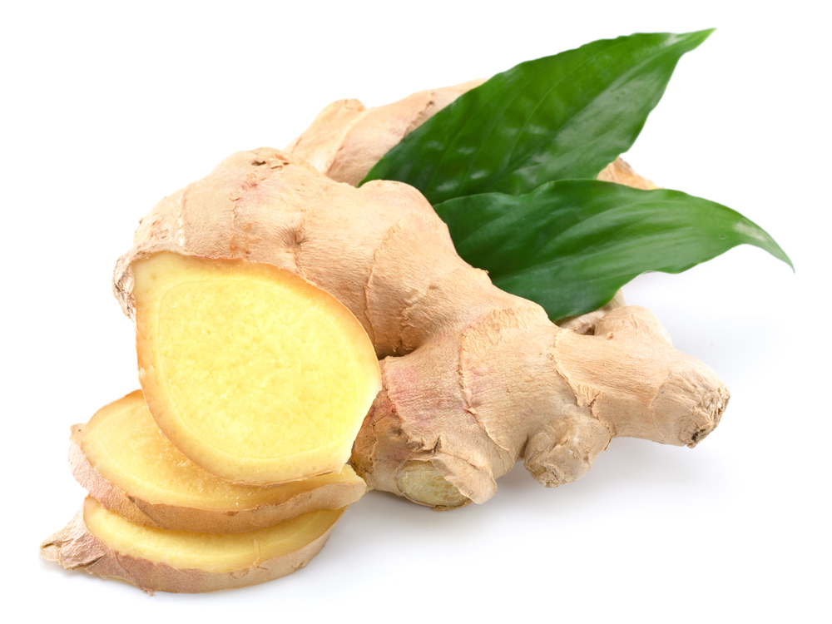
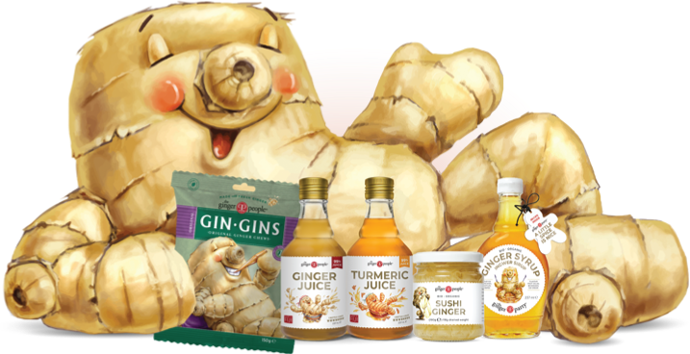
PICTURES

Slide 8
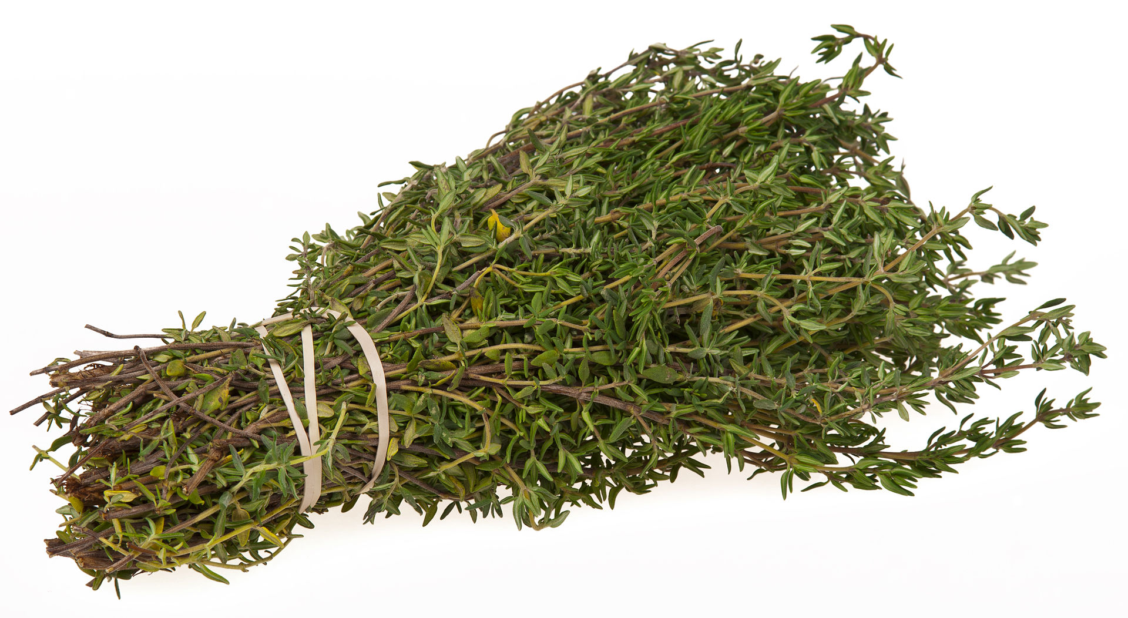
Thyme
What is THYME is good for?
Thyme is taken for bronchitis, cough, sore throat, colic, arthritis, upset stomach, stomach pain and skin disorders.
Thyme oil is used as a germ-killer in mouthwashes and liniments. It is also applied to the scalp to treat baldness and to the ears to fight bacterial and fungal infections.

Slide 9
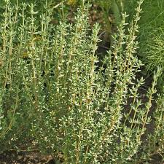
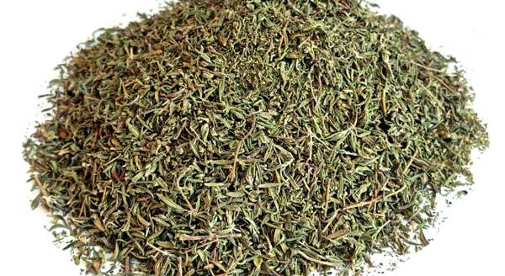
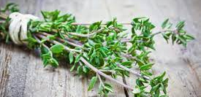

Slide 10
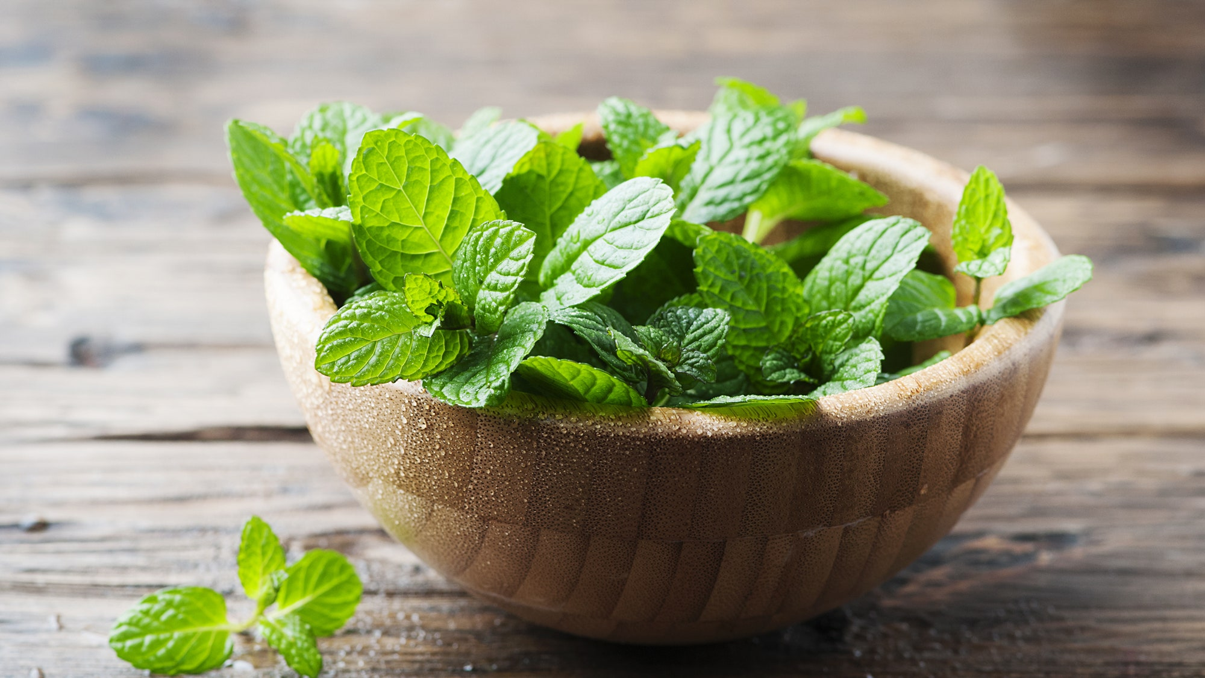
Spearmint
What is spearmint good for?
Spearmint is a delicious, minty herb that may improve your health.
It may help balance hormones, lower blood sugar and improve digestion. It may even reduce stress and improve your memory.

Slide 11
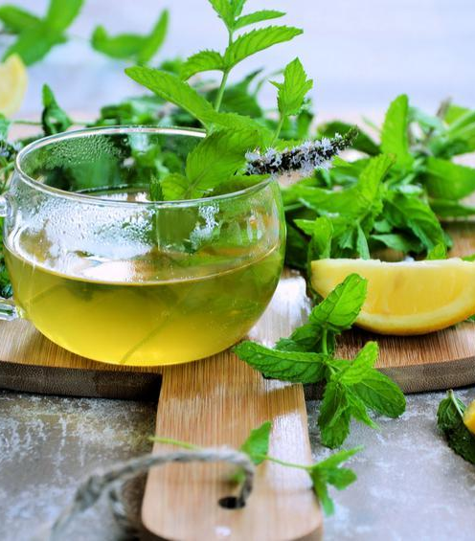
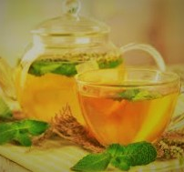

Slide 12
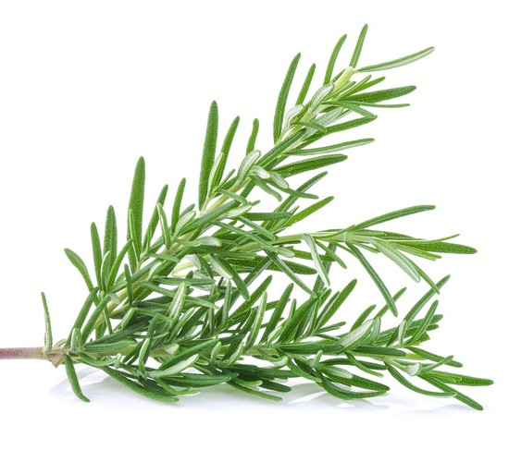
Rosemary
What is rosemary good for?
Rosemary is thought to help boost the immune system and improve blood circulation. It is considered a cognitive stimulant and can help improve memory performance and quality. It is also known to boost alertness, intelligence, and focus.

Slide 13
