Slide 1
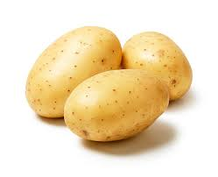
Oodles of potatoes
IOANNIS ST’2
16/11/2021

Slide 2
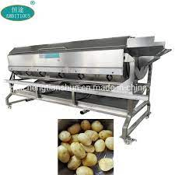
One day l bought one machine which was making potatoes

Slide 3
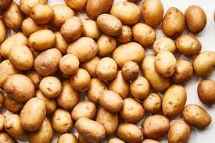
One day it made 1000000000000000000000000000000000000000000000000000000000000000000000000000000000000000000000000000kg potatoes.

Slide 4
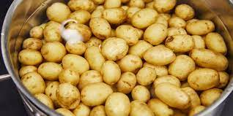
Overflowed all world in one week!!!

Slide 5
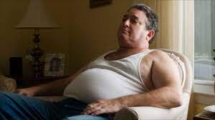
All people were forced to eat them. After that all people became fat!!!

Slide 6
At the end no one could switch off the machine

Slide 7
One weekend came one engineer to fix the machine

Slide 8
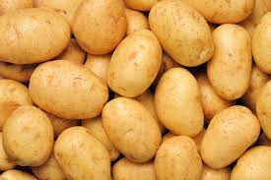
After it broke again and started all over

Slide 9
This time they used it for art or chemical to study them or to swim in them!!!

Slide 10
Then one person came with a giant vacuum cleaner.

Slide 11
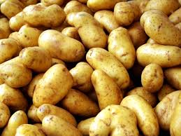
The vacuum did not suck the machine but it sucked the potatoes

Slide 12
So the greengrocers where they were selling potatoes, they didn’t sell potatoes any more

