Slide 1
Oodles of popcorn
Fanos Andreou
Year 6

Slide 2
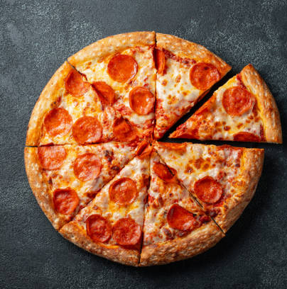
Once upon a time there was a boy named Fanos.
Fanos loved pizza but his mum always made for him popcorn. One morning Fanos wanted pizza for lunch but his mum made for him popcorn.

Slide 3
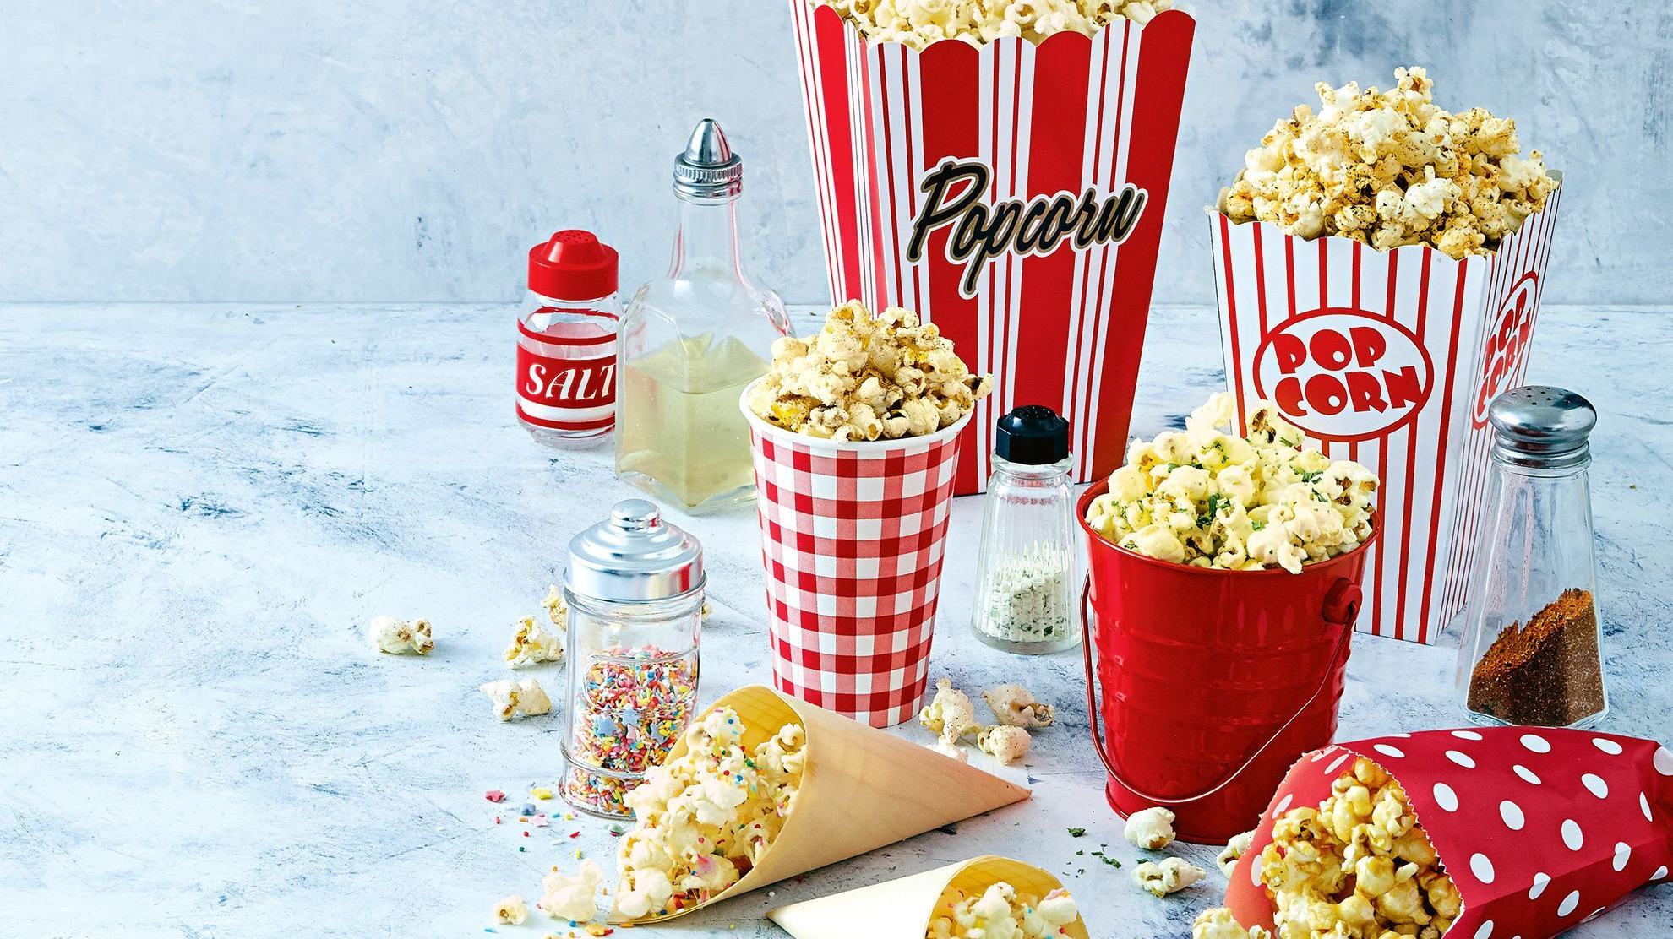
When Fanos was at school, his mum bought a machine that makes popcorn. When she was making popcorn for Fanos the machine couldn’t stop.

Slide 4
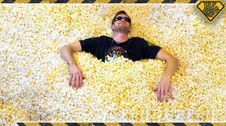
When Fanos got home the house was filled with popcorn. Fanos tried to stop the machine but it wasn’t stopping.

Slide 5
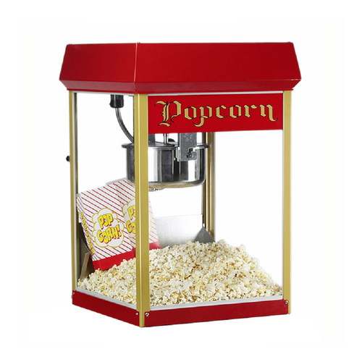
Then Fanos shouted" oodles of popcorn" and the machine stopped.

Slide 6
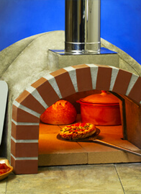
One week later Fanos mum started cooking for him pizza.

