Slide 1
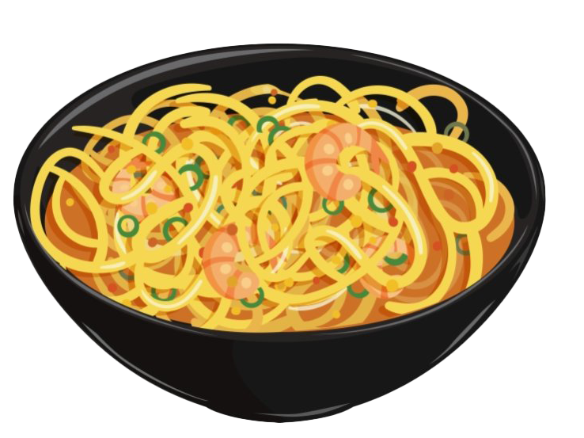
V.C Στ’1
Oodless of noodles

Slide 2
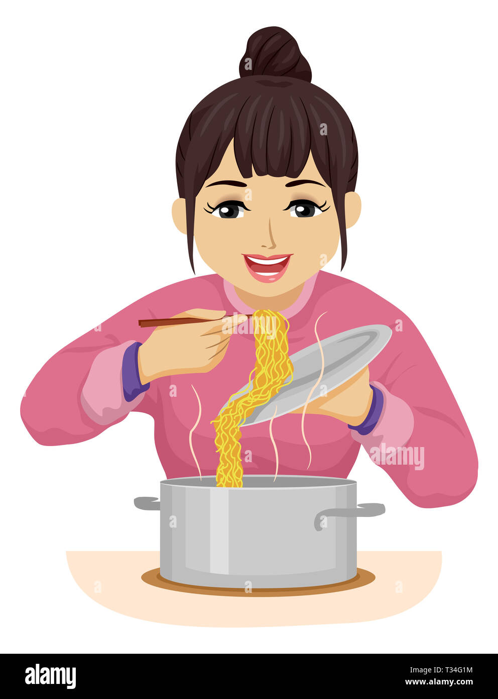
One day my mum made noodless with lollipops and
I went to school.
My mum made the noodless in the oven.

Slide 3
The oven made explosion and all noodles went out of the house. The noodles with lollipops went to school and all children started to shout. I ran as fast I could and I went to my house.

Slide 4
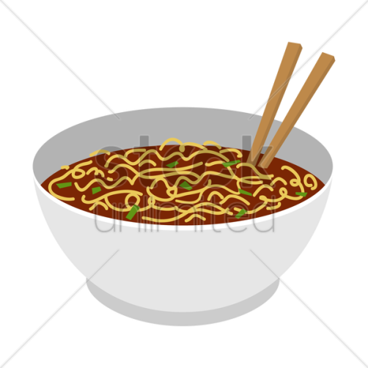
Mum what are you doing?
Trying to stop the oven.
Help!!!
Oodles of noodles with lollipops come out, come out of the oven my mom said.
‘’Stop oven, all noodles come out’’, I said.
And the oven stopped.
My mum and me were v very happy that we stopped the oven.
The children at school were very happy!!

